Slide 1

Made by -
Aman Jain,
Rahul Kumar,
Shubhranshu Yadav,
Paras Sharma

Slide 2

INTRDOCUTION
The purpose of the chat application is to allow users be able to the chat with each other, like a normal chat application. The users will be able to chat with each other, most likely only from user to user, no group chatting will be developed, unless there is time to do so.
The chat application will be written in java, but due to the lack of experience in java, while developing the application , practicing techniques with java and working on it as much as possible will help some java skills and be more ready to develop the application.

Slide 3
ABSTRACT
One of the learning outcomes listed by mobile computing education is to “Implement a
simple application that relies on mobile and wireless data communications”. This Android-based Instant Message Application is aimed to meet this outcome.
Since the Android mobile platform was first open sourced by Google in November 2007, it has attracted more than 180,000 developers and the deployment of 50,000 mobile applications in the Android Market. Today more than 60 smart phones from major manufactures run the Android platform. All these numbers show that the Android project has gained momentum and has moved forward. In addition to its openness, all the tools in the Android development are free and no special hardware is required. These factors motivated us to practice this application on the Android platform.

Slide 4
SCOPE
The idea of this project is to implement instant chat into a mobile application that supports messaging features in order to emphasize the communication aspect of the system.
The project’s outcome will be an Android application for smartphones and tablets. Therefore messaging can be easily passed when the family is traveling .

Slide 5
What are the WhatsApp Features to Consider?
WhatsApp Web UI Create rooms or groups Sign in with Google account Last seen for groups Messaging boxes [green for own and white for the replies of others] Send message in group with timestamp
Screenshot Disability

Slide 6
PROPOSED SYSTEM
The communication process has undergone a drastic change over the years. It has travelled quite a long distance right from the era of sending handwritten letters to the present age of instant messaging.
Today business is encountering a fierce competition in the market and so the need for real-time communication has augmented. Just a decade ago, the SMS was the order of the day, but with the evolution of time, the popular chat based apps have substituted its place. And it be clear-cut, one must thank the emergence of the Smartphones which has played a dominant role in bringing these apps to the forefront.

Slide 7
APPLICATION OF PROPOSED SYSTEM
Messages transfer does not require proper network connectivity
Security risks are less.
Data transfer is more efficient.
Cross platform simultaneous message transfer is possible.
Anonymous group chatting is possible.

Slide 8
SOFTWARE REQUIREMENTS
Messages transfer does not require proper network connectivity
Android Studio
Firebase
JAVA

Slide 9
EXISTING SYSTEM
1. Existing system has problems like lack of personal security.
DISADVANTAGE OF EXISTING SYSTEM
1. In existing system data transfer is not efficient.
2. Annoying due to constant messages.
3.Cross platform communication cannot be possible in existing system proper working internet connection is required lack of content censorship.

Slide 10
HARDWARE REQUIREMENT
Minimum requirements will be as follows:
1. 128 MB RAM required.
2. Processor with speed of 500mhz.
3. Internet or LAN connection.
4. KEYBOARD: 101 key Keyboard.

Slide 11
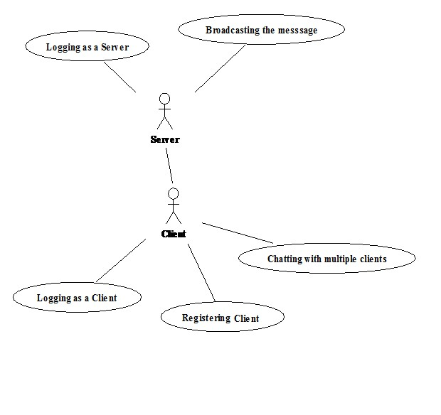
Use Case Diagram:

Slide 12
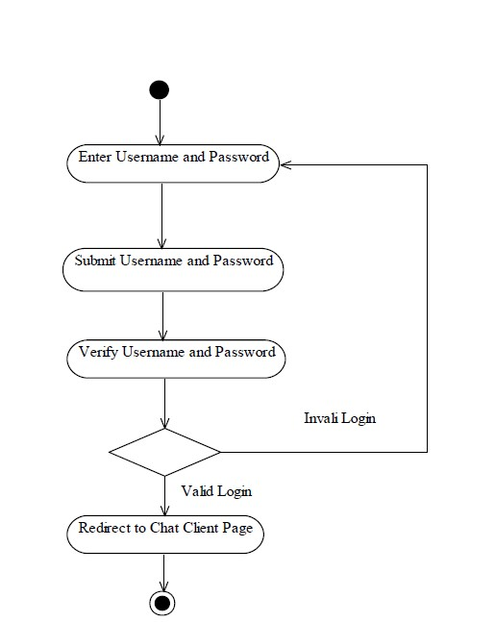
Activity Diagram For Login:

Slide 13
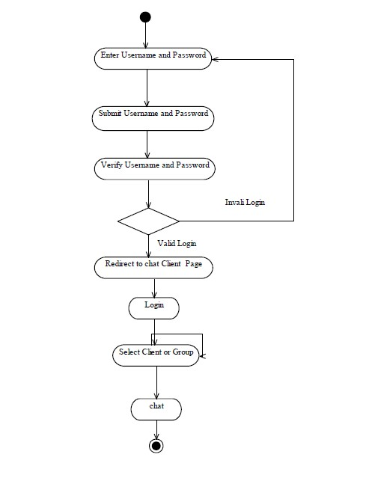
Activity Diagram For Chatting:

Slide 14
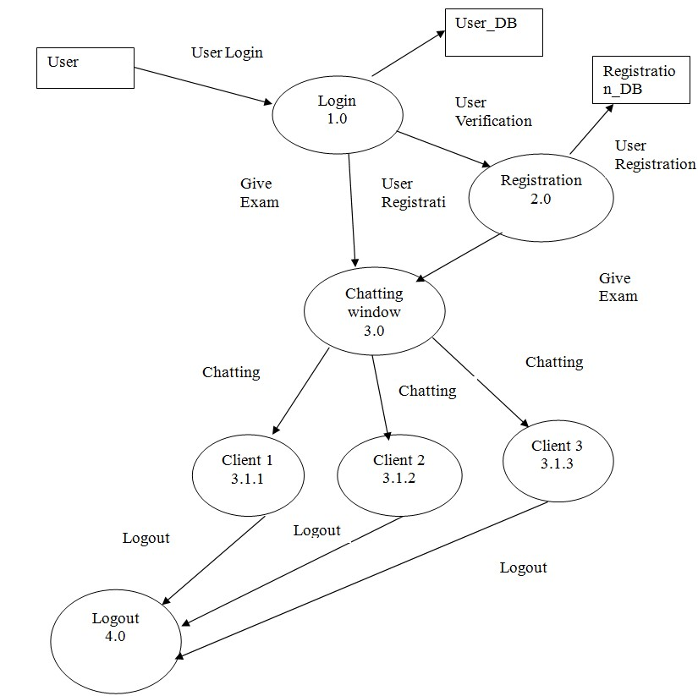
Data Flow Diagram:

Slide 15
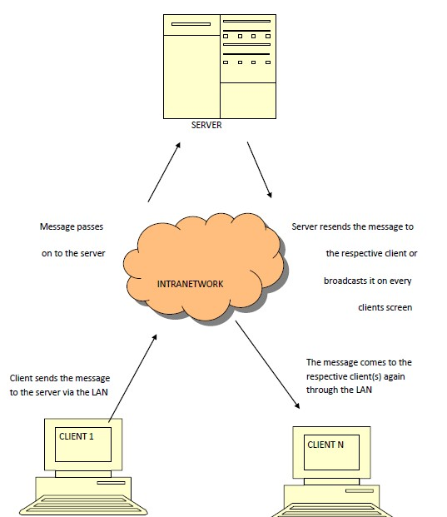
E-R Diagram:

